Slide 1
Ruminations on the History of Video Game Design
CS 4730 – Computer Game Design

Slide 2
History of Games
What better way to learn the history of games, then to go through it and play old games!

Slide 3
Generation 1 (1967-1975)
Magnavox Odyssey
Atari Pong System

Slide 4
Generation 1 (1967-1975)
Magnavox Odyssey
Atari Pong System

Slide 5
Generation 1 (1967-1975)
Notable features:
Simple controls: one rotary wheel to move ”character” along one dimension
VERY simple game loop. Play round -> count score
Rudimentary graphics (amazing at the time)!
Other notes:
Mostly marketed towards adults
Extremely popular despite simplicity

Slide 6
Generation 2 (1977-1983)
The rise of the arcade machines!!
Space Invaders (1978)
Galaxian (1979)

Slide 7
Generation 2 (1977-1983)
The rise of the arcade machines!!
PacMan (1980)
Donkey Kong (1981)

Slide 8
Generation 1 (1967-1975)
Notable features:
More advanced controls. Introduced joystick plus 1 or 2 action buttons
Colorful displays and animations
Design heavily influenced by arcade culture
Focused on lives, game overs, high scores
Social aspect of high score lists
Difficult / few lives to encourage feeding quarters

Slide 9
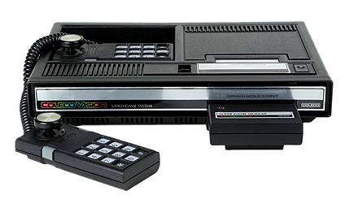
Generation 2 (1977-1983)
Gen 2 also contained a HUGE console market
ColecoVision
Atari 2600

Slide 10
Generation 2 (1977-1983)
Let’s Play Missile Command

Slide 11
Generation 2 (1977-1983)
Other popular games
Burger Time
Zaxxon

Slide 12
Gen 2: Console Market
Console games largely mimicked designs of arcade games.
High scores, lives, game over, etc.
Many of these didn’t translate over to home console market real well.
Who cares if you have the high score when you are the only one playing in your house.
The designs of games didn’t update w/ the new setting.
The games were still fun, just not optimal design.

Slide 13
The Stage of History
From 1979 through 1983, the video game industry was booming
New consoles practically every year
Atari 2600, Atari 5200, ColecoVision, Intellivision (and all its clones), Odessey, Vectrex
Startups were appearing all the time, pushing new titles consistently

Slide 14
The World of Balance
In 1982, Atari was clearing $2B and was recognized as the fastest growing US company EVER
Microcomputers were starting to appear with reasonable prices
Like the C64 and the TRS80

Slide 15
The World of Ruin
However, it was too much of a good thing
Many of the games that came out were just terrible
The publishers had little to no control over the content
In fact, this is when Activision was founded as an offshoot of Atari because Atari wouldn’t pay royalties based on sales

Slide 16
The World of Ruin
So many games came out that retailers ran out of shelf space
Games were discounted or sent back to publishers, who couldn’t pay the retailers for the unsold copies
Atari then published the “worst game ever”…
Actually, two worst games ever.

Slide 17
The World of Ruin
First: Pac Man (Atari 2600). 1982

Slide 18
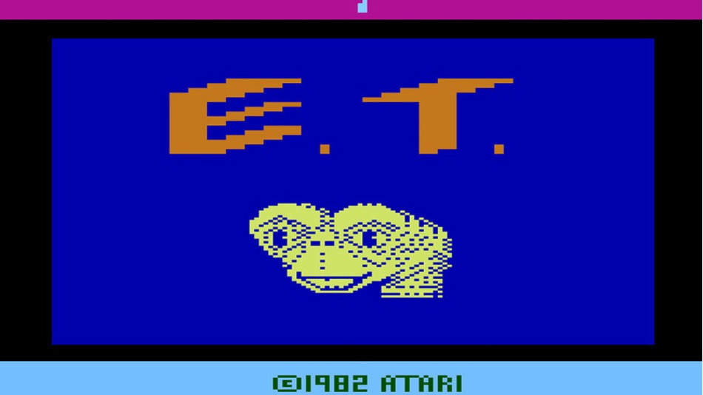
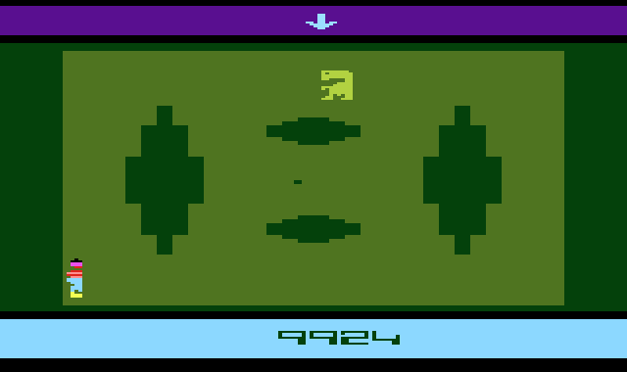
The World of Ruin
E.T.
Not only was it bad – it was also a movie license!

Slide 19
The World of Ruin
By 1984, Atari had filed for bankruptcy
It was at this point that the emerging dominance in the new electronic entertainment market moved from the US to Japan
To a company known for making playing cards
Nintendo

Slide 20

The Nintendo Seal of Quality

Slide 21
Generation 3 (1983-1986)
Gen 3 marked by the emergence of Japanese designers
Famicon (JP) / NES
Sega Master System

Slide 22
Now You’re Playing With Power
The NES was introduced in 1985 and took over the US market in 1987
It’s safe to say that the NES saved the video game industry
This is partially due to the more meticulous nature in which Nintendo reviewed games before approving them
Also consider the franchises that were born during this time frame

Slide 23
Nintendo’s reaction to crash
System marketed towards children
The NES seal of approval
The NES lockout chip:
People tried hard to get around this
Even fake lawsuits
A push towards game designs targeted more to home console market (see next slides)

Slide 24
Gen 3: Design Changes
Game Designs start moving away from the arcade format (not fully)
Fewer instances of high scores, leaderboards, etc.
Most games still had lives and game overs, but this was to extend the life of the game by arbitrarily increasing difficulty.
Because the amount of content still somewhat low

Slide 25
Gen 3: Features
Games became, for the first time, very character driven and narrative driven:

Slide 26
Gen 3: Let’s Play SMB
Let’s play the original Super Mario, Level 1

Slide 27
Gen 3: Let’s Play Zelda 1
Let’s play Zelda 1

Slide 28
Gen 3: Games I Recommend
Zelda 1 – Still great today!
Super Mario 1, 2, and 3
3 is definitely the must-play here. VERY polished.
Mega Man
Any is fine, but I think 2 and 3 are the best
One of the first times you could choose your level
Metroid – Flawed, but laid the metroidvania foundation.
There is a reason these became franchises

Slide 29
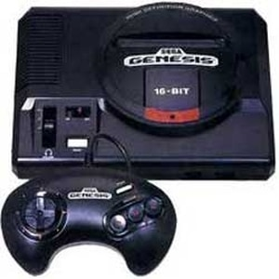
Generation 4 (1988-1994)
Gen 4 featured upgrades in the design of large epic games
Super Famicom (JP) / Super Nintendo (SNES
Sega Genesis

Slide 30
Gen 4: Features
Games could finally be at an epic scale as envisioned.
Meant designers had to be more clever about teaching players how to play.
With more complex games, came more complex designs to ease players in.
SNES games defined what it meant to “teach the player”
Many genres were polished and defined in this generation
Super Metroid and the metroidvania design established
Zelda formula established
RPG progression systems refined in Chrono Trigger, Final Fantasy, etc.
Mario refined the level design of platformers.
Games could be less punitive. Enough content without needing the extended lifetime.

Slide 31
Gen 4: Games I Recommend
Super Metroid: Defined metroidvania genre
Super Mario World: Polished the Mario formula and introduced Yoshi
RPGs (SNES might be best RPG system ever)
Chrono Trigger: One of the best! 13 endings!
Final Fantasy 4,5,6: Golden age (PS era good too)
Link to the Past: Established the Zelda formula
Fighters: Street Fighter 2 and Mortal Kombat 2/3

Slide 32
Generation 5 (1994-1999)
Gen 5 marked by the move to 3D games
Nintendo 64
Sony Playstation

Slide 33
Gen 5: Games I Recommend
n64:
Super Mario 64: Established the collect-a-thon style
GoldenEye007: Brought FPS to forefront. Established multiplayer FPS formula.
Zelda Ocarina of Time: Faithful translation of formula to 3D
Super Smash Bros.: Like nothing we had ever seen.

Slide 34
Gen 5: Games I Recommend
Playstation 1:
Castlevania Symphony of the Night: established the “vania” part of metroidvania genre
Metal Gear Solid: Quintessential stealth game
Final Fantasy 7-9: Everyone likes 7, 9 is better.
Tony Hawk’s Pro Skater 2: Often cited as one of the best games ever made.
Former student from this class currently working on the remaster of this game!!!

Slide 35
Generation 6 (2000-2004)
Microsoft enters market, PS2 best selling ever, GameCube flops
XBOX
GameCube
Playstation 2

Slide 36
Gen 6 and beyond
You are more familiar with this generation and beyond, so I won’t make recommendations here.
At this point, we see a lot of the game designs from the previous generations polished, increased in scale.
One big change is games start to become more and more cinematic, offering something closer to a Hollywood experience.
A lot of the franchises (FF, Mario, Zelda, etc.) start to get into a “flow” of using similar formulas with slight improvements over and over.
Open world games become more polished and popular (Grand Theft Auto, etc.)
…and much more

Slide 37
Generations 7 and 8
Generation 7 (2005 – 2012)
XBox360, PS3, Nintendo Wii / WiiU
Generation 8 (2013-2018)
PS4, Xbox One, Nintendo Switch
...and many more to come.

Slide 38
Things I left out!!
Handhelds!
Game Boy (1989): Pokemon Red/Blue most notable maybe
Not first handheld by long shot but maybe first notable one.
Game Gear (1990): Sonic the Hedgehog!
Virtual Boy (1995)
Game Boy Advance (2001)
Nintendo DS (2004)
PlayStation Portable (2004)
3DS, Vita, Nintendo Switch (2012-present)
…and many more!

Slide 39
Things I left out!!
PC Gaming!!
PC gaming was happening throughout the console lifetime we discussed.
Notable PC Games
Civilization (1991 - present): Strategy, complex simulation, building
Doom (1993): First big, violent FPS game
Warcraft / Starcraft (1994): Early real-time strategy game
Tomb Raider (1996): Early exploration based game
Diablo (1996): Early dungeon crawler
World of Warcraft (2004): Defined the MMO genre
Minecraft (2009): Not a game.
…and MANY more we don’t have space to list.

